Slide 1
C programming
Arrays, Decision and Looping

Slide 2

Lesson Objectives
Introduce
Array in C
Decision in C
Looping In C

Slide 3
Introduce
Section 1

Slide 4
Array in C
Section 2

Slide 5
Array in C. Agenda
What is Array?
Multidimensional Arrays
Array in memory
How to declare an Array?
How works with array?
When will using Array?

Slide 6
What is Array?
Each member of an array is identified by unique index or subscript assigned to it
The dimension of an array is determined by the number of indices needed to uniquely identify each element
An index is a positive integer enclosed in [ ] placed immediately after the array name
An index holds integer values starting with zero
An array with 11 elements will look like -
Player[0], player[1], player[2],…. Player[10]

Slide 7
Multidimensional Arrays
The simplest and the most commonly used multi-dimensional array is the two - dimensional array
A two-dimensional array can be thought of as an array of two single dimensional arrays
A two-dimensional array looks like a railway time-table consisting of rows and columns
A two–dimensional array is declared as -
int temp[4][3];

Slide 8
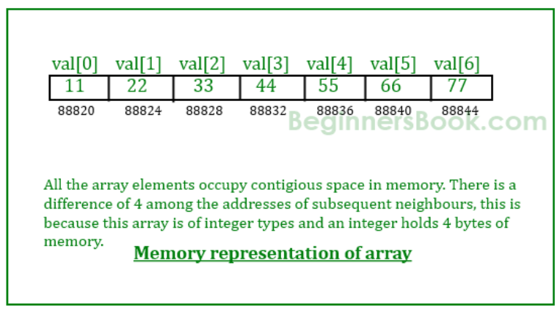
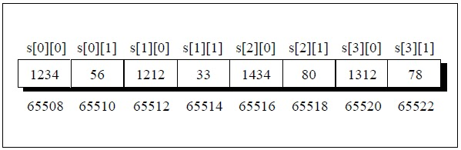
Array in memory

Slide 9
How to declare an Array?
An array is defined in the same way as a variable is defined. The only change is that the array name is followed by one or more expressions, enclosed within square brackets [], specifying the array dimension.
Storage_Class data_types array_name[size]
int player[11];

Slide 10
How works with array?
Array elements and index
Insert
Find
String
Sort
Delete

Slide 11
Array in C
When will using Array?

Slide 12
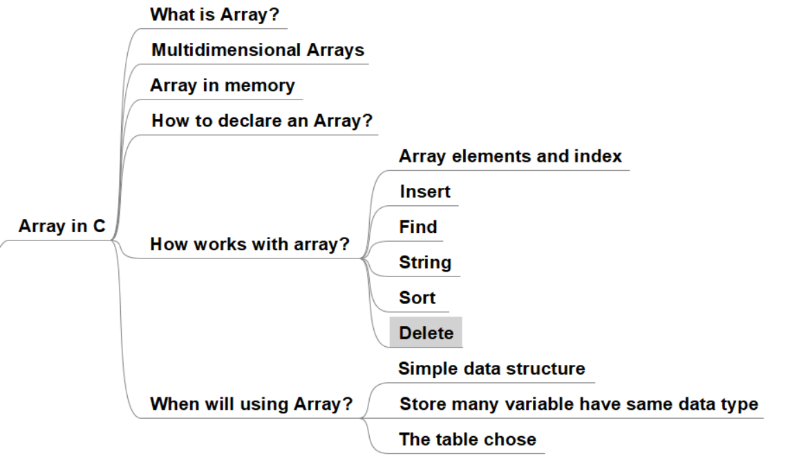
Array in C: Sumary

Slide 13
Decision in C
Section 3

Slide 14
Decision in C. Agenda
Introduce
How to build an expression?
if, else… statement
switch… statement

Slide 15
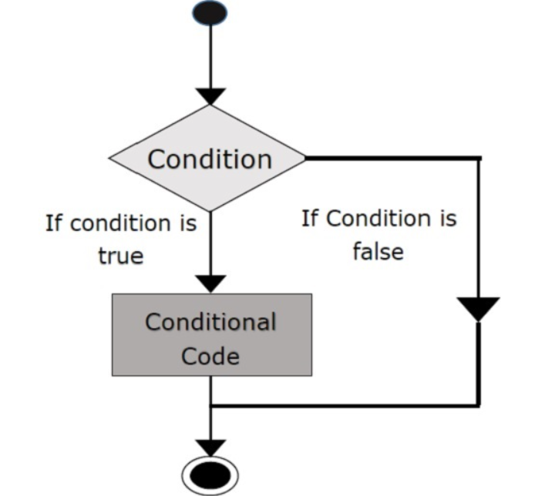
Introduce

Slide 16
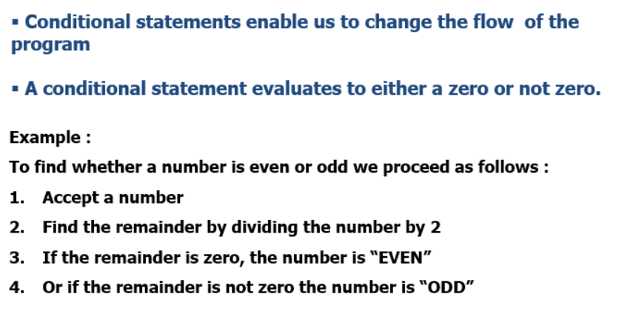
How to build an expression?

Slide 17
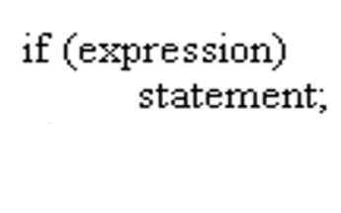
if, else… statement

Slide 18
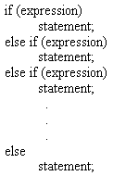
if, else… statement

Slide 19
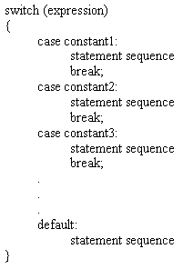
switch… statement

Slide 20
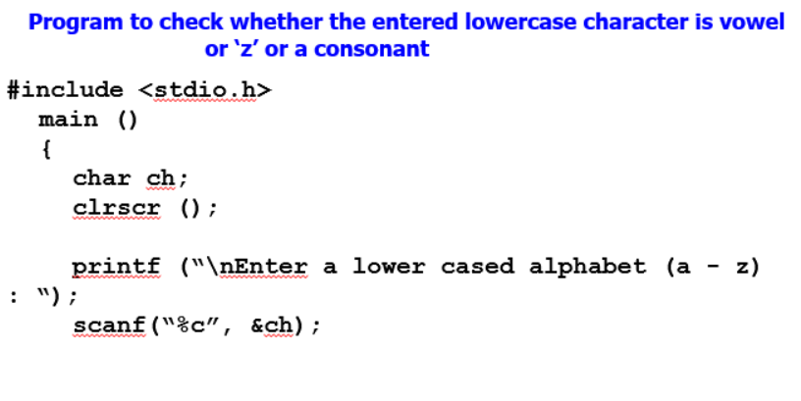
switch… statement

Slide 21
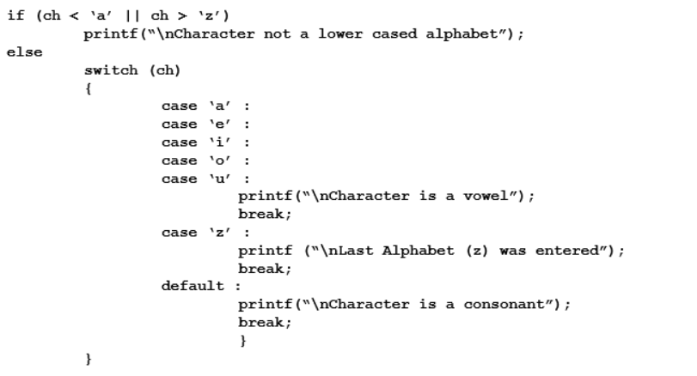
switch… statement

Slide 22
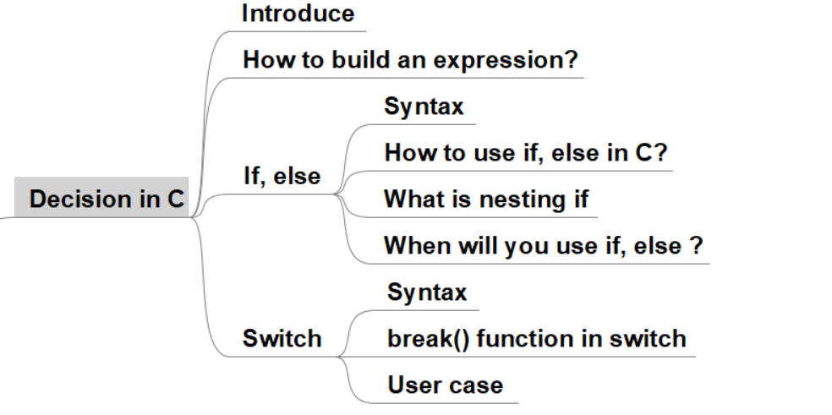
Decision in C. Summary

Slide 23
Looping In C
Section 4

Slide 24
Looping In C. Agenda
What is looping in C?
Syntax
Enter and exit, break looping follow.
How to use looping?
Key words for Looping

Slide 25
What is looping in C?
Section of code in a program
which is executed repeatedly,
until a specific condition is satisfied

Slide 26
Syntax
The for loop
The while loop
The do….while loop

Slide 27
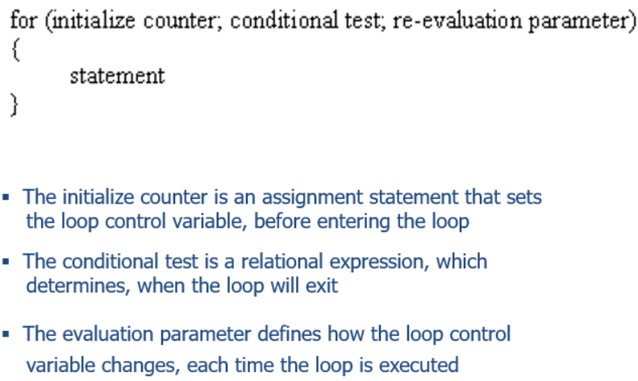
Syntax: The for loop

Slide 28
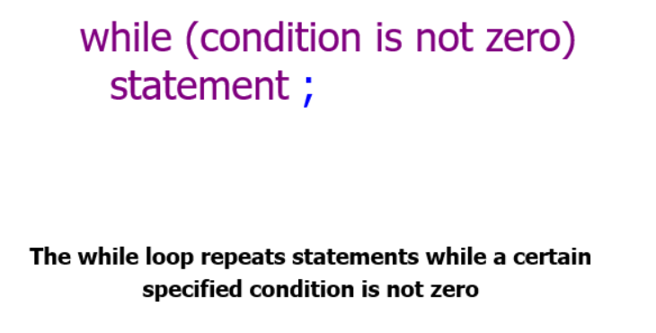
Syntax: The while loop

Slide 29
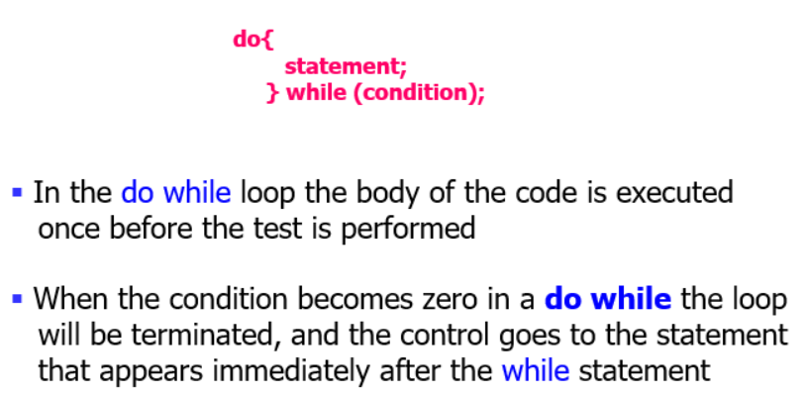
Syntax: The do….while loop

Slide 30
Enter and exit, break looping follow.
Enter and exit, break looping follow ?

Slide 31
How to use looping?
- Know number of loop.
- Unknow number of loop.

Slide 32
Key words for Looping
- Goto
- Continue
- Exit()
- Break()
- Return

Slide 33
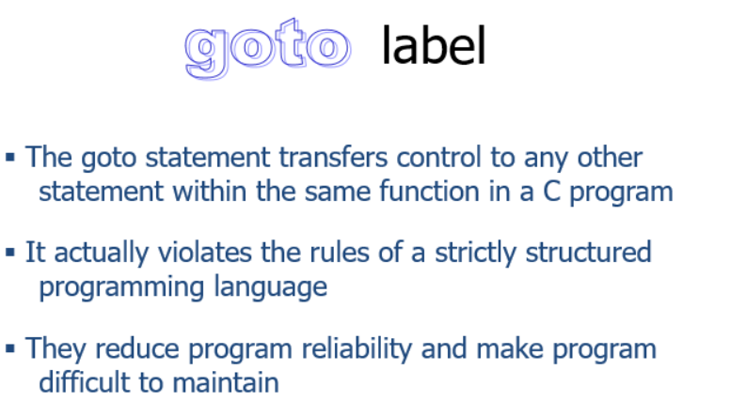
Key words for Looping: Goto

Slide 34
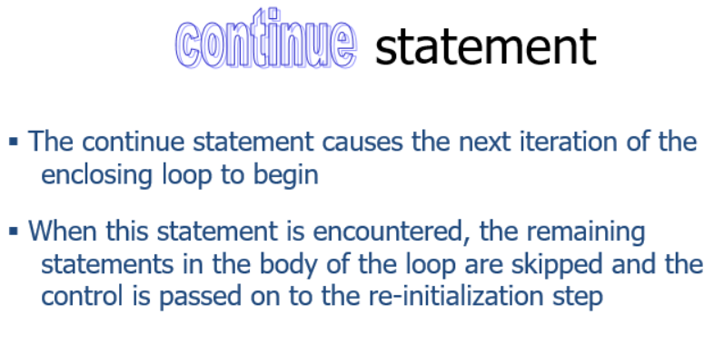
Key words for Looping: Continue

Slide 35
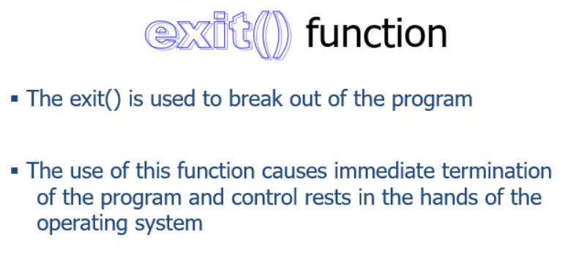
Key words for Looping: Exit()

Slide 36
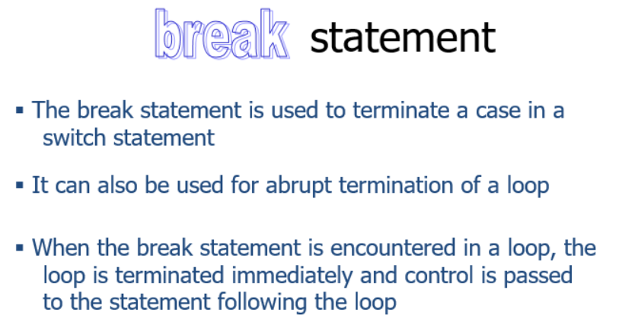
Key words for Looping: Break()

Slide 37
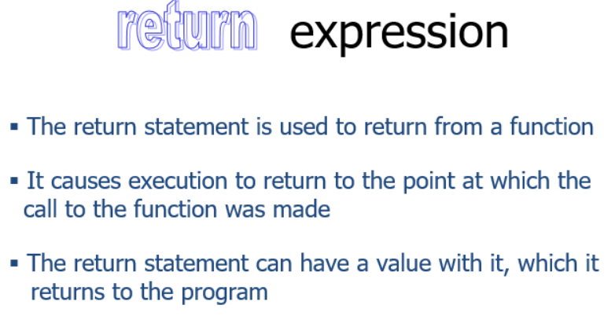
Key words for Looping: Return

Slide 38
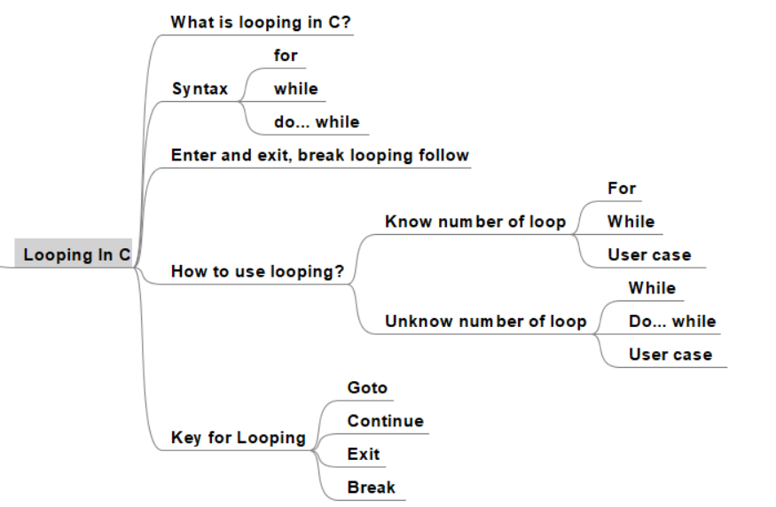
Looping In C. Summary

Slide 39
Lesson Summary
Array in C
Decision in C
Looping In C

Slide 40

Thank you

